Slide 1

Cars4u project
By
Lavina Kunder

Slide 2

BACKGROUND
There is a huge demand for used cars in the Indian Market today. As sales of new cars have slowed down in the recent past, the pre-owned car market has continued to grow over the past years and is larger than the new car market now. Cars4U is a budding tech start-up that aims to find footholds in this market.
As a senior data scientist at Cars4U, you have to come up with a pricing model that can effectively predict the price of used cars and can help the business in devising profitable strategies using differential pricing. For example, if the business knows the market price, it will never sell anything below it.

Slide 3
PROBLEM DEFINITION
OBJECTIVE:
Explore and visualize the dataset.
Data Pre-processing.
Build a linear regression model to predict the prices of used cars.
Testing of Assumptions and Model Performance Evaluation of Linear Regression Model.
Generate a set of insights and recommendations that will help the business.

Slide 4
DATA INFORMATION
The data is for customers of Cars4U that focus on reselling used cars:
Name | Type | Information
S.No | Integer | Serial Number
Name | Object | Names of Cars
Location | Object | 11 Cities in India
Year | Integer | Range from 1996 – 2019
Kilometers_Driven | Integer | Ranges from 171 – 6500000km
Fuel_Type | Object | 5 unique types
Transmission | Object | Manual / Automatic
Owner | Object | 4 Types
Mileage | Object | Ranges from 0 – 34 kmpl
Engine | Object | Ranges from 72 CC to 5998 CC
Power | Object | Ranges from 34 – 616 bhp
Seats | Float | Ranges from 0 – 5 seats
New_Price | Object | Price of new car of same model
Price | Float | Ranges from Rs.44000 – Rs 1.6 Crore
There are a 7253 rows and 14 columns
There are 9 attributes of type OBJECT (Strings).
There are 3 attributes of type INTEGER.
There are 2 attributes of type FLOAT.
TOTAL : 14 Attributes.

Slide 5
DATA PREPROCESSING I
This part of Data Pre-processing is done to understand the DataSet better and for UNIVARIATE and BIVARIATE Exploratory Data Analysis.
Further Data Pre-processing will be done after EDA is complete.
Pre Processing Done :
1) DROP UNNECESSARY COLUMNS (S.No and New_Price)
2) PROCESSING COLUMNS (Mileage, Engine and Power are converted from Object Type to Float Type)

Slide 6
DATA PREPROCESSING I
DATA SET INFORMATION
Now there are 12 attributes/columns as compared to the initial 14
7 attributes have no missing values. (Name, Location, Year, Kilometers_Driven, Fuel_Type, Transmission, Owner_Type)
5 attributes have missing values. (Mileage, Engine, Power, Seats, Price)

Slide 7
UNIVARIATE ANALYSIS

Slide 8
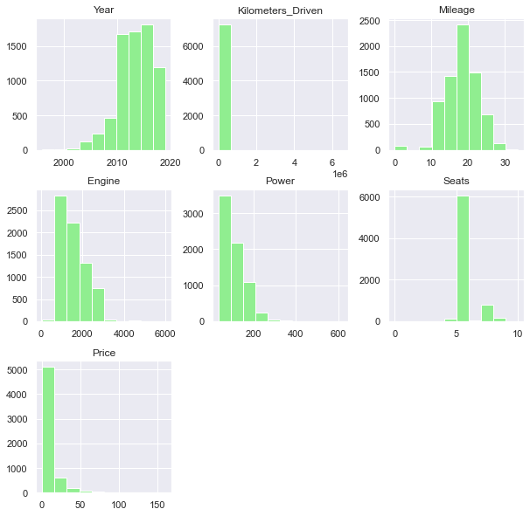
Histogram Plots
Histogram Plots of the various numerical Attributes present in the given Dataset. It shows the frequency of each element within the attribute.

Slide 9
Observations
Seats ranges from 0 to 10 with the average around 5
Price ranges from Rs. 44000 to Rs. 1.6 Crore with the average around Rs. 9.5 Lakhs
There are Multiple Unique values in Name, Mileage, Engine, Power and New_Price.
Location has 11 Unique Values (Mumbai, Pune, Chennai, Coimbatore, Hyderabad, Jaipur, Kochi, Kolkata, Delhi, Bangalore, Ahemdabad)
Fuel_Type has 5 Unique Values (CNG, LPG, Petrol, Diesel, Electric)
Transmission has 2 Unique Values (Manual and Automatic)
Owner_Type has 4 Unique Values (First, Second, Third, Fourth and Above)

Slide 10
Observations
The Skew in the attribute Year, Kilometers_Driven and Price is clearly visible.
Most cars have 5 - 6 seats.
Skew can also be notes in Engine and Power pretty clearly
Mileage ranges from 0 to 34 with the average around 18
Engine ranges from 72 CC to 5998 CC with the average around 1616 CC
Power ranges from 34 bhp to 616 bhp with the average around 112.8 bhp
The DataSet contains information on 7253 people.
Year ranges from 1996 to 2019 with the average around 2013
Kilometres_Driven ranges from 171 Km to 6500000 Km with the average around 58699 Km

Slide 11
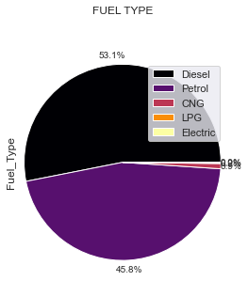
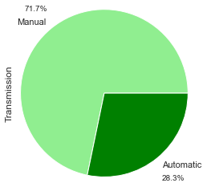
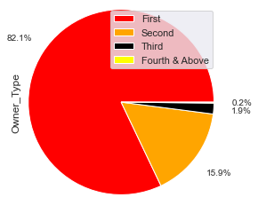
Variable Analysis
Diesel is the most preferred at 53% followed by Petrol at 46%. They make up most of the dataset with CNG, LPG and Electric having negligible values.
Manual Transmission is most preferred at 72% with Automatic at 2nd with 28%
Most people are the First Owners of the car accounting for 82% of the DataSet. Second Owners come 2nd at 16%. Other types take negligible values in the DataSet.

Slide 12
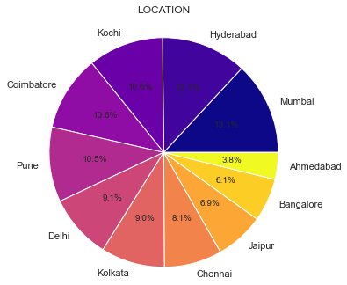
Variable Analysis
Mumbai is the most frequently appearing city with Ahemedabad as least with a difference of approximately 10% between them.
Kochi, Coimbatore and Pune come 2nd averaging at 10.5%
Delhi and Kolkata come 3rd averaging at 9%
Chennai is 4th with 8%
Jaipur and Bangalore at 5th averaging at 6.5%

Slide 13
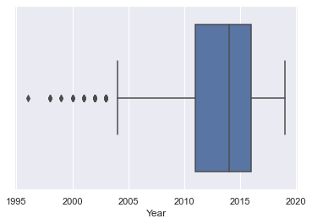
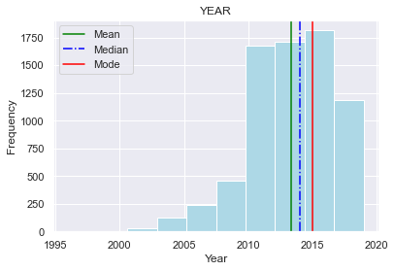
YEAR
Mode > Median > Mean --> NEGATIVELY SKEWED
The DataSet has a higher concentration of people preferring cars made from 2010 to 2019.
There are also outliers present.

Slide 14
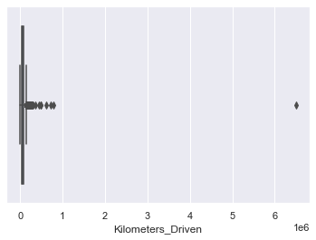
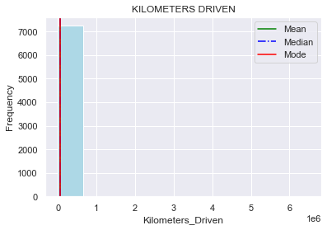
KILOMETERS DRIVEN DISTRIBUTION
Mode < Median < Mean --> POSITIVELY SKEWED
There are also outliers present.

Slide 15
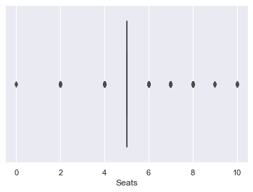
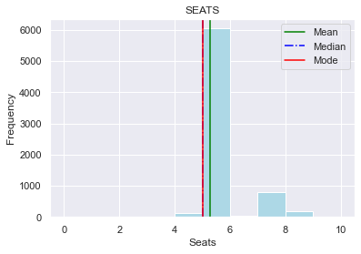
SEATS DISTRIBUTION
Mode = Median = 5 Seats
Most people prefer cars with 5 seats.
Mean > Median : Small Postive Skew
Outliers Present

Slide 16
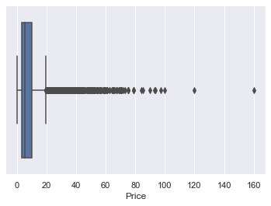
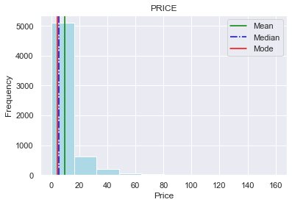
PRICE DISTRIBUTION
Mode < Median < Mean --> POSITIVELY SKEWED
Majority prefer cars in the price range Rs. 0 - 20 lakh
Outliers Present.

Slide 17
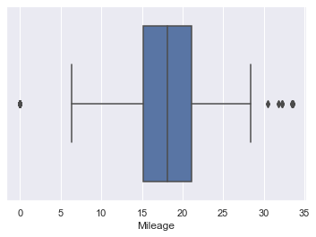
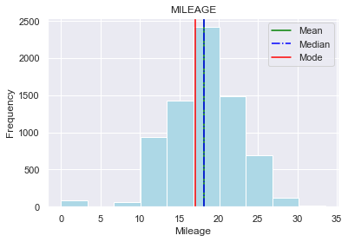
MILEAGE DISTRIBUTION
Mean = Median
Normally Distributed (Very Small Skew)
Most cars have mileage ranging from 13 to 23.
Outliers Present.

Slide 18
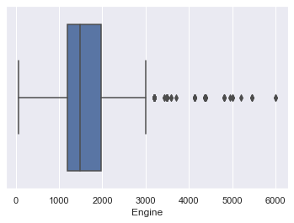
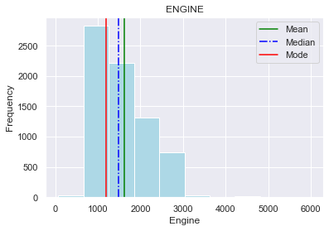
ENGINE DISTRIBUTION
Mode < Median < Mean
Slight Postive Skew
Most cars have 500 to 2000 CC Engine
Outliers Present.

Slide 19
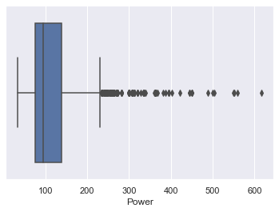
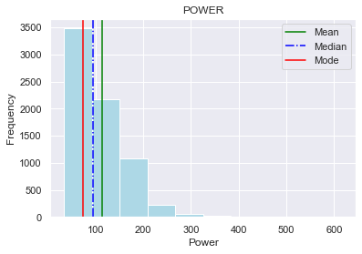
POWER DISTRIBUTION
Mode < Median < Mean
Slight Postive Skew
Most cars have 0 to 150 bhp
Outliers Present.

Slide 20
BIVARIATE ANALYSIS

Slide 21
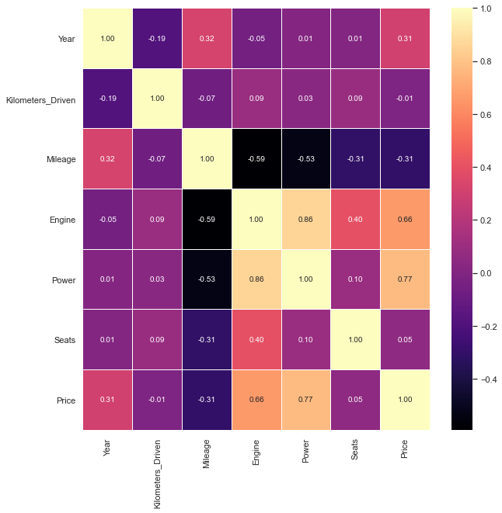
Correlation Heat Map
This Heat Map shows the correlation between the individual attributes. With this we can draw the following inferences :
1) There is distributed correlation between the attributes of this dataset.
2) The Highest Correlation is between 'Engine' and 'Power' with 0.86.
3) The Lowest Correlation is between 'Engine' and 'Mileage' with -0.59 (Negative).
4) Engine, Power and Price show strong dependency amongst each other.
5) Mileage has negative correlation with most attributes.

Slide 22
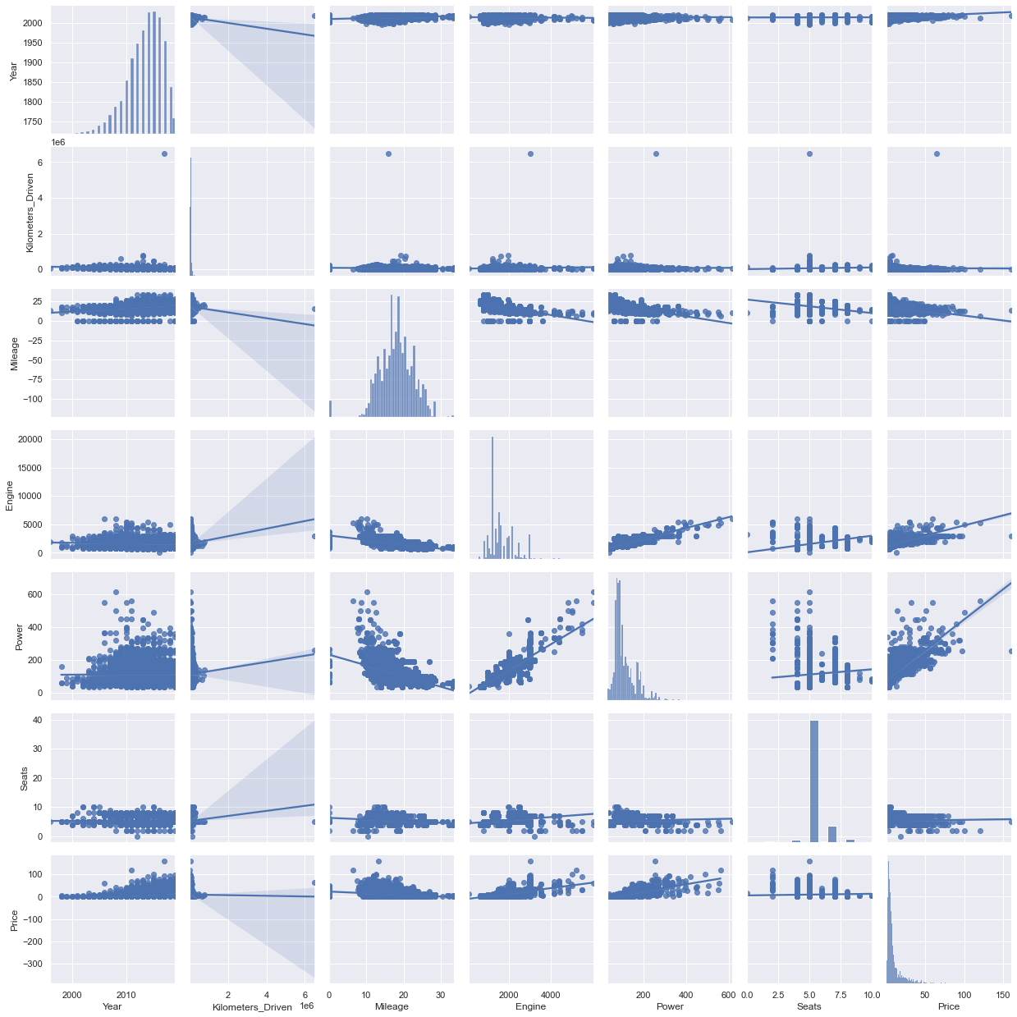
Pair Plot

Slide 23
Pair Plot

Slide 24
Pair Plot
Pairplot to show the relationship between the different variables. It is a more graphical representation of the Correlation Heat Map.

Slide 25
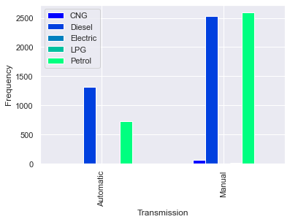
TRANSMISSION V/S FUEL TYPE
OBSERVATIONS
Manual Transmission is more preferred than Automatic
CNG driven cars are only available in Manual Transmission
LPG and Electric cars are too few in number to be visible on the graph

Slide 26
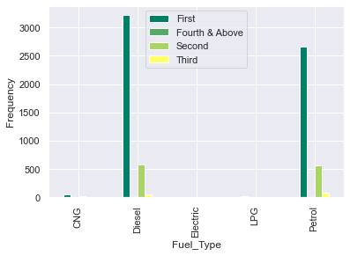
FUEL TYPE V/S OWNER TYPE
OBSERVATIONS
Most people prefer Diesel or Petrol Cars.
People prefer being the first owners of the cars that they buy

Slide 27
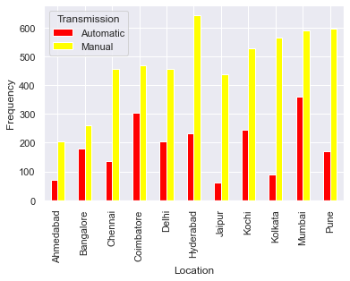
LOCATION V/S TRANSMISSION
OBSERVATIONS
All cities prefer Manual over Automatic Transmission
Hyderabad has the highest Manual Transmission cars
Mumbai has the highest Automatic Transmission cars and also the highest number of cars in total.

Slide 28
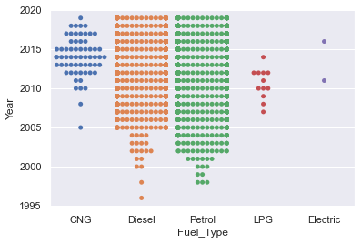
FUEL TYPE V/S YEAR
OBSERVATIONS
CNG, LPG and Electric cars are relatively newer; with manufacturing year ranging from 2008 to 2019
Diesel Cars have the oldest manufacturing years then followed by Petrol Cars.

Slide 29
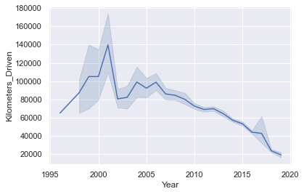
YEAR V/S KILOMETERS DRIVEN
OBSERVATIONS
As the years increase; the kilometers driven seems to decrease. Except for the sharp spike in 2001.
This could be because of the fact that as the years progress; people prefer being the first owners of the car therefore cutting down on the kilometers driven by previosu owners.

Slide 30
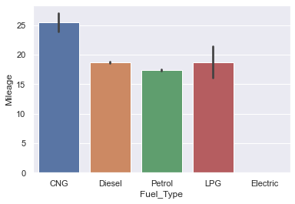
MILEAGE V/S FUEL TYPE
OBSERVATIONS
CNG cars give the most mileage followed by LPG, Diesel and then Petrol.
Mileage value of electric cars is missing owing to the fact that it has no tangible source of fuel. Therefore consumption per km cannot be checked.

Slide 31
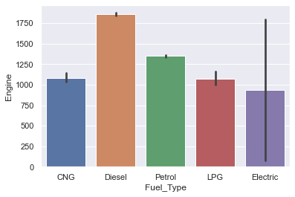
ENGINE V/S FUEL TYPE
OBSERVATIONS
Diesel cars have the most displacement volume of engine followed by Petrol, CNG, LPG and Electric.

Slide 32
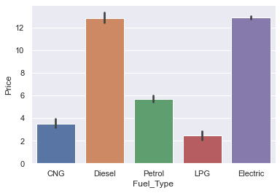
PRICE V/S FUEL TYPE
OBSERVATIONS
Electric cars are the most expensive cars followed by Diesel cars, Petrol, LPG and CNG.

Slide 33
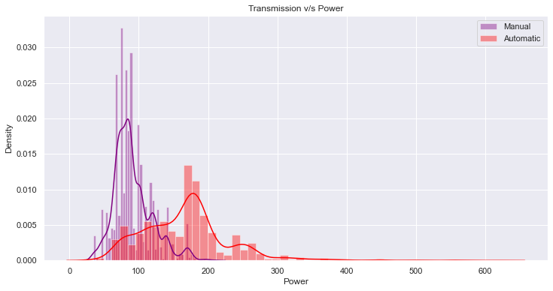
TRANSMISSION V/S POWER
OBSERVATIONS
Automatic Transmission cars are displayed to have more power than the Manual Transmission Cars.

Slide 34
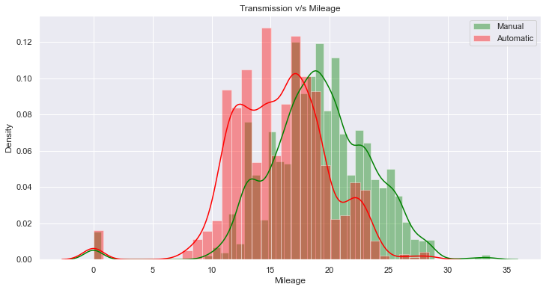
TRANSMISSION V/S MILEAGE
OBSERVATIONS
Both being relatively normally distributed; Manual Cars give more Mileage than Automatic Ones.

Slide 35
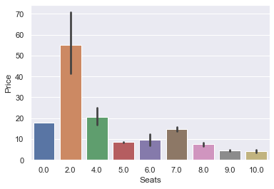
PRICE V/S SEATS
OBSERVATIONS
2 seater cars are shown to be most expensive. Owing to the fact that they might be sports cars.
It is followed by 4,0,7,6,5,8,9,10 seater cars in that order.

Slide 36
MULTIVARIATE ANALYSIS

Slide 37
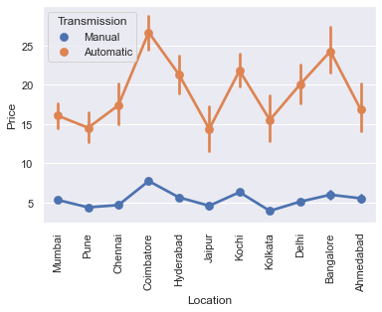
PRICE V/S LOCATIONS V/S TRANSMISSION
OBSERVATIONS
Manual Transmission cars are cheaper than Automatic Transmission cars.
Coimbatore, Hyderabad, Kochi and Bangalore a higher price range of cars than the other states for both Transmissions

Slide 38
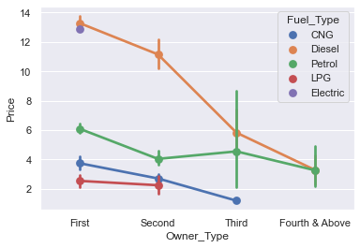
PRICE V/S OWNER TYPE V/S FUEL TYPE
OBSERVATIONS
Electric cars are not pre owned.
As the number of previous owners increase; the price of the car falls.
LPG cars have only First and Second Owners.
CNG cars do not have 4 or more previous owners.

Slide 39
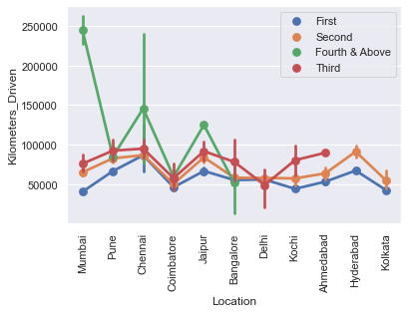
KILOMETERS DRIVEN V/S LOCATIONS V/S OWNER TYPE
OBSERVATIONS
Kilometers Driven increases as the number of previous owners increases.
Four and More previously owned cars show very high values for Kilometers Driven.
Kolkata and Hyderabad only have First and Second Owned Cars.
Bangalore, Delhi, Kochi and Ahmedabad have First,Second and Third Owned cars.
The other cities have all types of previously owned cars.

Slide 40
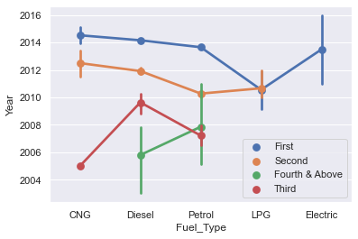
YEAR V/S FUEL TYPE V/S OWNER TYPE
OBSERVATIONS
As the number of previous owners increase; the manufacturing year of the car grows older. (Moves back)
First Owned cars have latest manufacturing dates while fourth owned have older manufacturing dates.

Slide 41
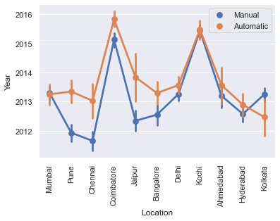
YEAR V/S LOCATIONS V/S TRANSMISSION
OBSERVATIONS
Most cities have newer Automatic Transmission cars than Manual ones, except for Kolkata where it is vice versa.
Coimbatore and Kochi have the latest cars for both Manual and Automatic transmission.

Slide 42
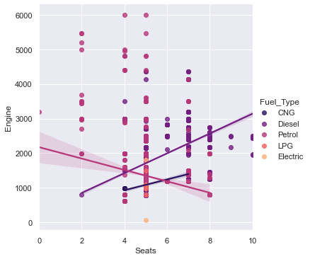
SEATS V/S ENGINE V/S FUEL TYPE
OBSERVATIONS
For CNG and Diesel cars; as the number of seats increase, the displacement volume of the engine increases as well.
For Petrol; as the number of seats increase, the displacement volume of the engine decreases.
LPG and Electric cars are mostly concentrated at 5 seats and hence trends for increasing or decreasing number of seats cannot be observed.

Slide 43
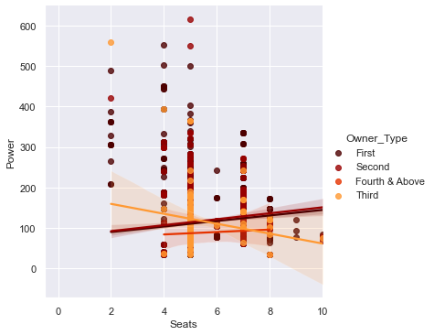
SEATS V/S POWER V/S OWNER TYPE
OBSERVATIONS
First, Second and Four & Above owned cars show an increase in Power as the number of seats increase.
Third owned cars show a decrease in Power and the number of seats increases.

Slide 44
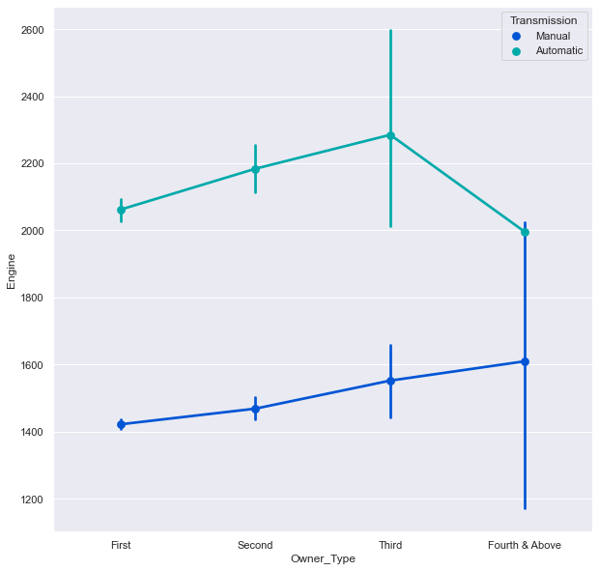
ENGINE V/S OWNER TYPE V/S TRANSMISSION
OBSERVATIONS
Automatic cars have a higher engine displacement volume than Manual Transmission cars.
For Manual Transmission, as number of owners increase; there is a rise in the Engine Displacement Volume.
Automatic Transmission cars show similar trends; except when the car is owned 4 or more times, where the engine displacement volume is shown to decrease.

Slide 45
Key Insights based on EDA
People prefer cars manufactured from 2010 to 2019
Most people prefer cars with 5 seats.
Most preferred price range : 0 to 20 Lakhs.
Mumbai appears most on the dataset and Ahmedabad the least (10% difference between them)
Diesel cars are most preferred followed by Petrol. Other types have negligible values.
Manual Transmission is most preferred at 72% with Automatic at 28%.
Most people are first owners with the percentage rising as the years progress.
Most cars have mileage ranging from 3 - 13
Most cars have a 500 - 2000 CC Engine
Most consistent Power range is 0 - 150 bhp

Slide 46
Key Insights based on EDA
Manual Transmission is more preferred than Automatic
CNG driven cars are only available in Manual Transmission
All cities prefer Manual over Automatic Transmission
Hyderabad has the highest Manual Transmission cars
Mumbai has the highest Automatic Transmission cars and also the highest number of cars in total.
CNG, LPG and Electric cars are relatively newer; with manufacturing year ranging from 2008 to 2019
Diesel Cars have the oldest manufacturing years then followed by Petrol Cars.
As the years increase; the kilometers driven seems to decrease. Except for the sharp spike in 2001. (This could be because of the fact that as the years progress; people prefer being the first owners of the car therefore cutting down on the kilometers driven by previous owners.)
CNG cars give the most mileage followed by LPG, Diesel and then Petrol.

Slide 47
Key Insights based on EDA
Diesel cars have the most displacement volume of engine followed by Petrol, CNG, LPG and Electric.
Electric cars are the most expensive cars followed by Diesel cars, Petrol, LPG and CNG.
Automatic Transmission cars are displayed to have more power than the Manual Transmission Cars.
Both being relatively normally distributed; Manual Cars give more Mileage than Automatic Ones.
2 seater cars are shown to be most expensive. Owing to the fact that they might be sports cars.
Manual Transmission cars are cheaper than Automatic Transmission cars.
Coimbatore, Hyderabad, Kochi and Bangalore a higher price range of cars than the other states for both Transmissions
Electric cars are not pre owned.
As the number of previous owners increase; the price of the car falls.

Slide 48
Key Insights based on EDA
LPG cars have only First and Second Owners.
CNG cars do not have 4 or more previous owners.
Kilometers Driven increases as the number of previous owners increases.
Four and More previously owned cars show very high values for Kilometers Driven.
Kolkata and Hyderabad only have First and Second Owned Cars.
Bangalore, Delhi, Kochi and Ahmedabad have First,Second and Third Owned cars.
The other cities have all types of previously owned cars.
As the number of previous owners increase; the manufacturing year of the car grows older. (Moves back)
Most cities have newer Automatic Transmission cars than Manual ones, expept for Kolkata where it is vice versa.
Coimbatore and Kochi have the latest cars for both Manual and Automatic transmission.

Slide 49
Key Insights based on EDA
For CNG and Diesel cars; as the number of seats increase, the displacement volume of the engine increases as well.
For Petrol; as the number of seats increase, the displacement volume of the engine decreases.
LPG and Electric cars are mostly concentrated at 5 seats and hence trends for increasing or decreasing number of seats cannot be observed.
First, Second and Four & Above owned cars show an increase in Power as the number of seats increase.
Third owned cars show a decrease in Power and the number of seats increases.
Automatic cars have a higher engine displacement volume than Manual Transmission cars.
For Manual Transmission, as number of owners increase; there is a rise in the Engine Displacement Volume.
Automatic Transmission cars show similar trends; except when the car is owned 4 or more times, where the engine displacement volume is shown to decrease.

Slide 50
Recommendations based on EDA
Specific Marketing strategies catering to older cars focusing on the lower prices to sttract customers.
Drawing more attention to cars with more seats by targetting audiences with bigger extended families living together.
Expensive cars like the Electric ones and 2 seater sports cars can be branded as luxury items and can attract customers. Also encourage customers to sell the car in a few years in favour of the new ones with more features.
Focusing on Petrol and Diesel Prices for marketing strategies to ensure sales dont fall.
Marketing Electric, LPG and CNG cars as ecofriendly.
Creating an easy to understand chart to explain which cars may be more suitable to which city terrain.
Draw more attention to Automatic transmission cars by showing that they are easier to drive.

Slide 51
Recommendations based on EDA
As CNG cars give more mileage than any other type of car; draw customer attention to this fact to show them that they can save money.
Specific Marketing Strategies based on the Engine and Power output of the car.

Slide 52
DATA PREPROCESSING II
This part of Data Preprocessing is done to cater to the Model Building part of the project. It will help in easier development of the Linear Regression Model
CONTINUATION : Pre-Processing Done:
3) FIXING MISSING VALUES : Missing Values across the Numeric Columns are replaced with the median of the column
4) FIXING DATA TYPE : Conversion of Object Type Column to Category Type.
5) OUTLIERS AND THEIR TREATMENT : Identifying the outliers in all columns and treating them. Using IQR to treat the outliers.

Slide 53
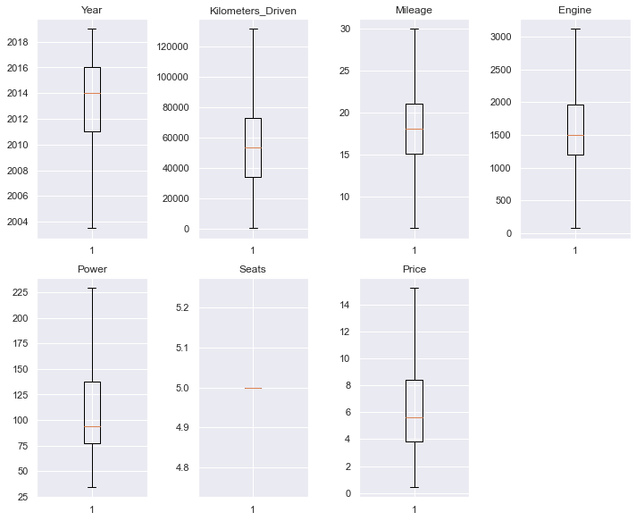
DATA PREPROCESSING II
Plot shows that outliers have been treated.
There are no missing values in the dataset now.
All object type attributes have been converted to Category Type

Slide 54
MODEL BUILDING

Slide 55
STEP 1: IMPORTING LIBRARIES from sklearn.linear_model import LinearRegression from sklearn.model_selection import train_test_split STEP 2: DEFINING X & Y VARIABLES X (Independent Variables) : Location, Year, Kilometers_Driven, Fuel_Type, Transmission, Owner_Type, Mileage, Engine, Power, Seats y (Dependent Variable) : Price STEP 2: CREATING DUMMY VARIABLES The Categorical Columns in this dataset cannot be read by the equation pertaining to model building. So we create simple true or false columns with their titular equivalent and column value. These will be used as independent variables without imposing any kind of ordering between the values of that particular column. In this case; the Categorical Columns are : 1) Location 2) Fuel_Type 3) Transmission 4) Owner_Type

Slide 56
STEP 3: SPLITTING THE DATA INTO TRAINING AND TESTING SET 70% Training Data Set (5077 rows) 30% Testing Data Set (2176 rows) STEP 4: MODEL BUILDING Linear Regression Equation : y = aX + b where: y = Dependent Variable a = Intercept b = Slope X = Independent Variables 1) INTERCEPT or 'a' VALUE : Intercept of the linear equation: [-819.8219374] 2) COEFFICIENTS or SLOPE VALUE : In simple or multiple linear regression, the size of the coefficient for each independent variable gives you the size of the effect that variable is having on your dependent variable, and the sign on the coefficient (positive or negative) gives you the direction of the effect. In regression with multiple independent variables, the coefficient tells you how much the dependent variable is expected to increase (if the coefficient is positive) or decrease (if the coefficient is negative) when that independent variable increases by one, holding all the other independent variables constant.

Slide 57
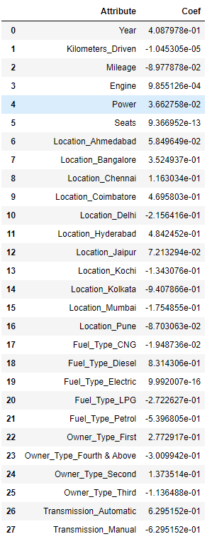
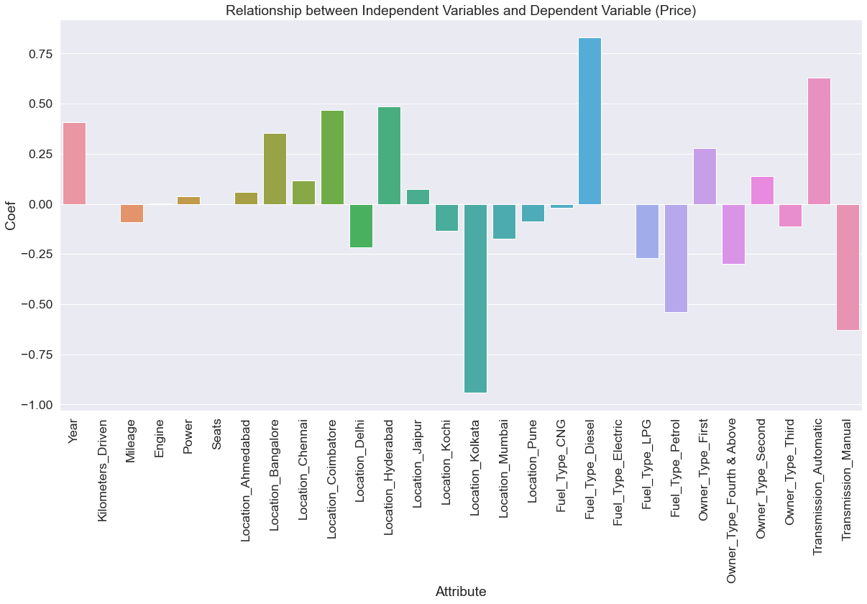

Slide 58

STEP 4: MODEL BUILDING 2) COEFFICIENTS or SLOPE VALUE : As understood from the graph. Few variables have a strong relationship with the price of the car. This relationship can either be Positive or Negative. SIGNIFICANT POSITIVE EFFECT : Year, Location(Bangalore, Chennai), Fuel_Type(Diesel), Owner_Type(First), Automatic Transmission SIGNIFICANT NEGATIVE EFFECT : Location(Kolkata), Fuel_Type(LPG,Petrol), Owner_Type(Second), Manual Transmission 3) $R^{2}$ VALUE : It is a regression metric which tells us the amount of variance explained. Best possible score is 1.0, and it can be negative because the model can be arbitrarily worse. A constant model that always predicts the expected value of y, disregarding the input features, would get a R^2 score of 0.0. - Training Data Score : 0.6847420515999858 - Testing Data Score : 0.715571624528472 $R^{2}$ value is 0.71, which means that in this model's independent variables are able to explain 71% of the variance in the dependent variable. Therefore; it is a satisfactory model. The training and testing scores are 68% and 71%, and both scores are comparable. Hence, the model is a good fit.

Slide 59

STEP 4: MODEL BUILDING 4) MODEL PERFORMANCE EVALUATION - Mean Absolute Error : 1.6333095620442801 - Root Mean Square Error : 2.2839305825824274 Smaller RMSE and MAE value is preferred. In our case; the values are quite decent as the dataset is quite large. All 3 performance evaluation values ( 𝑅2 , MAE and RMSE) can be improved. 𝑅2 can be increased by including more variable attributes. Efforts can be made to reduce the MAE and RMSE values as well 5) ADDING INTERACTION TERMS (To increase the $R^{2}$ value) - Training Data Score (After Addition of Interaction Terms) : 0.7120245156036937 - Testing Data Score (After Addition of Interaction Terms) : 0.7661134722908403 But this is at the cost of adding new interaction terms and therefore more variables.

Slide 60
STEP 4: MODEL BUILDING 6) FINAL EQUATION OF THE MODEL Price = ( 0.40879779963848883 ) * Year + ( -1.045304873765375e-05 ) * Kilometers_Driven + ( -0.08977878224484184 ) * Mileage + ( 0.0009855126063751068 ) * Engine + ( 0.036627580178181685 ) * Power + ( 9.366951658762446e-13 ) * Seats + ( 0.05849649253841341 ) * Location_Ahmedabad + ( 0.35249370890987153 ) * Location_Bangalore + ( 0.11630341981972431 ) * Location_Chennai + ( 0.469580257537356 ) * Location_Coimbatore + ( -0.21564162299846631 ) * Location_Delhi + ( 0.4842451710290928 ) * Location_Hyderabad + ( 0.07213293696261694 ) * Location_Jaipur + ( -0.13430764983008867 ) * Location_Kochi + ( -0.9407866252394254 ) * Location_Kolkata + ( -0.1754854538536489 ) * Location_Mumbai + ( -0.08703063487159302 ) * Location_Pune + ( -0.01948736051800722 ) * Fuel_Type_CNG + ( 0.8314305635116409 ) * Fuel_Type_Diesel + ( 9.992007221626409e-16 ) * Fuel_Type_Electric + ( -0.2722626863211187 ) * Fuel_Type_LPG + ( -0.5396805166781 ) * Fuel_Type_Petrol + ( 0.2772916758203992 ) * Owner_Type_First + ( -0.3009942191891403 ) * Owner_Type_Fourth & Above + ( 0.13735138361864174 ) * Owner_Type_Second + ( -0.11364884025382557 ) * Owner_Type_Third + ( 0.6295151998733405 ) * Transmission_Automatic + -0.6295151998734724

Slide 61
MODEL INSIGHTS
Year, Location(Bangalore, Chennai), Fuel_Type(Diesel), Owner_Type(First), Automatic Transmission have a strong positive relationship with the price of the car.
Location(Kolkata), Fuel_Type(LPG,Petrol), Owner_Type(Second), Manual Transmission have a strong negative relationship with the price of the car.
Intercept of the linear equation: [-819.8219374]
𝑅2 value is 0.71 (Testing Set), which means that in this model's independent variables are able to explain 71% of the variance in the dependent variable. Therefore; it is a satisfactory model.
The training and testing scores are 68% and 71%, and both scores are comparable. Hence, the model is a good fit.
MAE (Mean Absolute Error) = 1.6333095620442801 AND RMSE (Root Mean Square Error) = 2.2839305825824274
Smaller RMSE and MAE value is preferred. In our case; the values are quite decent as the dataset is quite large.

Slide 62
MODEL INSIGHTS
All 3 performance evaluation values ( 𝑅2 , MAE and RMSE) can be improved. 𝑅2 can be increased by including more variable attributes. Efforts can be made to reduce the MAE and RMSE values as well
Addition of Interaction terms increases the 𝑅2 for both the training and testing set. But this is at the cost of additonal variables in the dataset.
AFTER ADDITION OF INTERACTION VARIABLES : 𝑅2 for Training Set : 0.7120245156036937 ; 𝑅2 for Testing Set : 0.7661134722908403

Slide 63
MODEL RECOMMENDATIONS
Focus on the attributes: Year, Location(Bangalore, Chennai), Fuel_Type(Diesel), Owner_Type(First), Automatic Transmission, Location(Kolkata), Fuel_Type(LPG,Petrol), Owner_Type(Second), Manual Transmission; to understand how to price the car correctly.
Use of other methods to derive linear regression models to understand how they might help in understanding the dataset better and the differences in the various methods.
It will also allow us an opportunity to understand which method works best under what scenarios.
Work towards reducing MAE and RMSE values.

Slide 64
THANK YOU

